Slide 1
Fundamentals of Laser
OUTLINE
Definition and Properties of Laser.
Mechanisms of Light Emission.
Important terms in laser.
Nd:YAG laser.
Helium-Neon laser.
Holography.

Slide 2
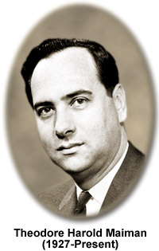
Definition of Laser
The acronym LASER stands for
Light Amplification by Stimulated
Emission of Radiation.
A laser is a device that generates
light by a process called
STIMULATED EMISSION.
In 1960, T. H. Maiman built the first laser device (ruby laser)

Slide 3
Properties of Laser
(a) Monochromatic
(b) Directionality
(c) Coherent
(d) Divergence
(e) Intensity
Notes:
Coherent-Phase difference between two waves is constant.
Divergence-It is measure of angle substended by beam at distance form emergence.

Slide 4
Mechanisms of Light Emission
For atomic systems in thermal equilibrium with their surrounding, the emission of light is the result of:
Absorption
And subsequently, spontaneous emission of energy
There is another process whereby the atom in an upper energy level can be triggered or stimulated in phase with the an incoming photon. This process is:
Stimulated emission
It is an important process for laser action
Therefore ,3 process of light emission:
1. Absorption
2. Spontaneous Emission
3. Stimulated Emission

Slide 5
Absorption
E₂
E₁
Corresponding to each transition from E₁ to E₂, photon of energy hν = E₂ – E₁ is absorbed and the atom is excited.
The number of atoms excited during time Δt is, N_{ab} = B₁₂N₁QΔt
Notes:
B12 – coefficient of stimulated absorption.
N1- No. of atoms in Ground state.
Q-Energy density of incident Radiation.

Slide 6
Spontaneous Emission
E₂
E₁
Corresponding to each transition from E₂ to E₁, photon of energy
hν = E₂ – E₁ is emitted.
The number of atoms de-excited during time Δt by spontaneous emission is, N_{sp} = A₂₁N₂Δt
Notes:
A21 – coefficient of Spontaneous emission.
N2- No. of atoms in Excited state.
Q-Energy density of incident Radiation.

Slide 7
Spontaneous Emission Cont….
Photons emitted in all directions and on a random time scale.
The emitted photons are INCOHERENT

Slide 8
Stimulated Emission
E₂
E₁
Corresponding to every transition from E₂ to E₁ , two identical
photons of energy hν = E₂ – E₁ are emitted.
The number of atoms de-excited during time Δt by stimulated emission is, N_{st} = B₂₁N₂QΔt.
Notes:
B21 – coefficient of stimulated emission.
N2- No. of atoms in Excited state.
Q-Energy density of incident Radiation.

Slide 9
Stimulated Emission…...
Stimulated emission is the process by which an incoming photon of a specific frequency can interact with an excited atomic electron causing it to drop to a lower energy level.
The liberated energy transfers to the electromagnetic field, creating a new photon with a phase, frequency, polarization, and direction of travel that are all identical to the photons of the incident wave.

Slide 10
Stimulated Emission…...
The emission then goes into the same direction as the incoming photon. In effect, the incoming radiation is amplified.
stimulated emission can only occur for incoming photons that have a photon energy close to the energy of the laser transition.

Slide 11
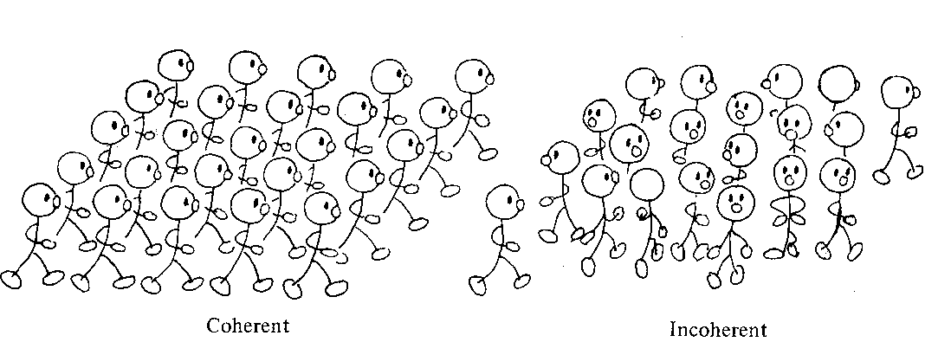
Coherent and incoherent.

Slide 12
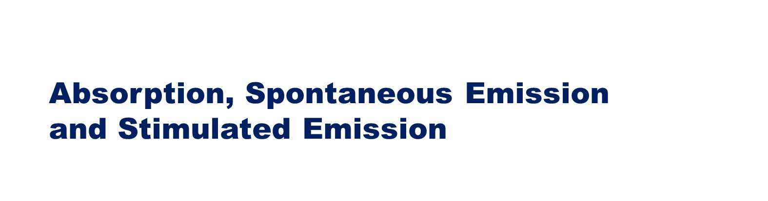
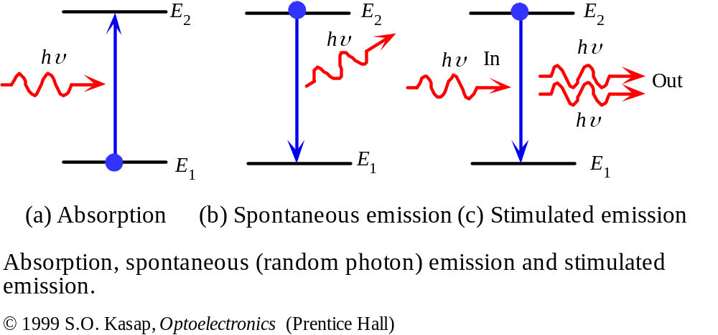

Slide 13
Advantages of stimulated emission over spontaneous emission
(a) The process is controllable from outside.
(b) The induced radiation is identical to the incident radiation.
(c) By selecting proper active medium and resonance
conditions, light amplification can be achieved.
(d) As a result, we get a highly monochromatic, coherent,
directional, focused and intense radiation.
Notes:
Photons emitted in all directions and on a random time scale.
The emitted photons are INCOHERENT

Slide 14
Population Inversion
In an ensemble of atoms having only two energy levels (a ground state and an excited state), the excited atoms can amplify light.
Those atoms in the ground state can absorb light, which brings them back to the excited state.
Net amplification can then be achieved only when more than 50% of the atoms are in the excited state.
This condition is called population inversion.
Laser gain is more easily achieved when there is a mechanism that rapidly removes the atoms from the lower energy level after each emission event

Slide 15

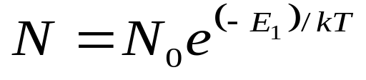

(a) Population
(b) Population inversion
N₂>> N₁
(c) Active system or active medium
(d) Meta stable state
(e) Pumping
(f) Resonant cavity
Notes:
N0-constant.
N-No. of atoms per unit volume in energy E1.

Slide 16
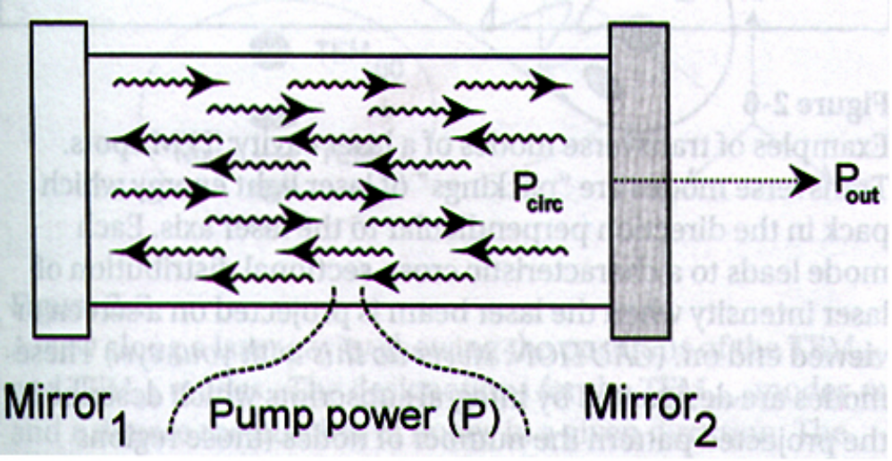
    Resonant Cavity
Create a laser cavity, which consists of the lasing medium and two highly reflective mirrors.

Slide 17
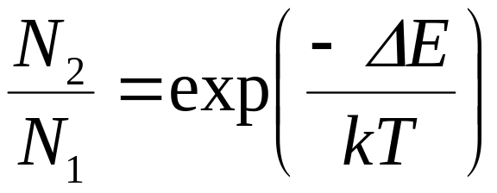
How to achieve Population inversion…..
When kT is large, the ratio of N₂/N₁≈1, equal numbers of molecules in state 1 and state 2.
When kT is small the ratio of N₂/N₁ ≈ 0 and all molecules are in state 1.
Cannot obtain a population inversion using thermal
methods in a 2 level system.

Slide 18
Important terms and concepts in lasers contd.....
(g) Pumping schemes
E₃
E₄
Non
Radiative
Non
Radiative
C.B.
Metastable
state
E₃
Metastable
state
E₂
Laser
transition
Laser
transition
Pumping
Pumping
E₂
Laser
transition
Pumping
Non
Radiative
V.B.
E₁
E₁
Ground
state
Two level pumping
Three level pumping
Four level pumping

Slide 19
Types of laser sources
(a) Solid state lasers
(b) Gas lasers
(c) Molecular Laser
(d) Tuneable lasers/ Dye lasers
(e) Diode lasers
(f) Chemical lasers

Slide 20
Requirements for Laser Action
fast
Metastable state
slow
Population inversion
slow relaxation
efficient pumping
Fast relaxation

Slide 21
Holography
Holography is derived from Greek words holos means complete
and gramma means photography.
Conventional photography is only a two dimensional record of light intensity received from an object.
Holography is the technique in which, both the phase as well as amplitude of light waves is recorded.
It is basically a two step process.
Step 1) Constructing a hologram
Step 2) Viewing a hologram

Slide 22
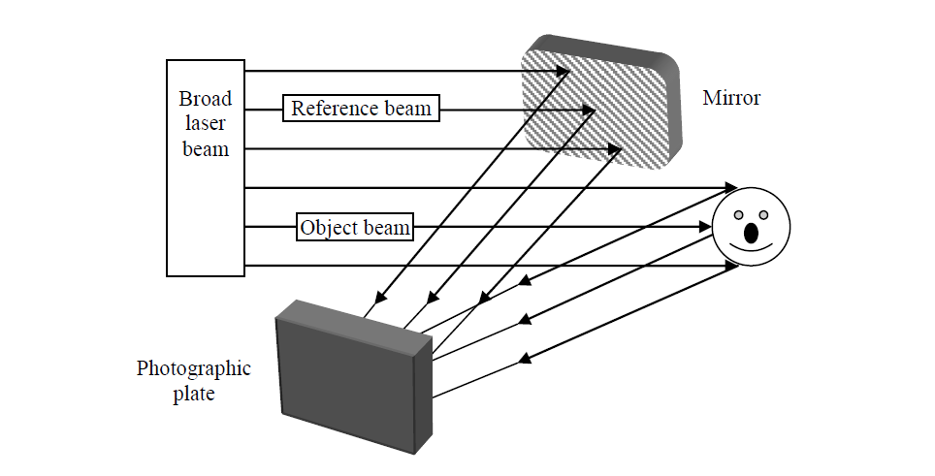
Holography contd....
Step 1) Constructing a hologram

Slide 23
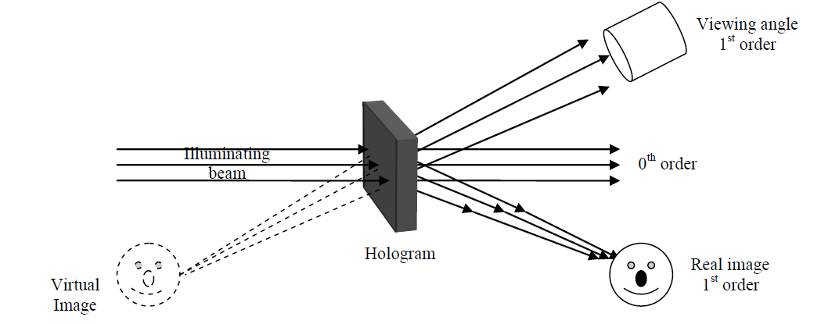
Holography contd....
Step 2) Viewing a hologram

Slide 24
THANKS

